Slide 1
Building maintainable web applications using React –
An evaluation of architectural patterns used in Canvas LMS

Slide 2
In order to choose a suitable topic for investigation within the Canvas LMS, a few requirements had to be fulfilled:
• The topic of choice must comply with industry norms.
• It ought to make use of modern technologies.
• Its dimensions ought to be reasonable.
Recently, Canvas LMS switched to using React for all client-side development instead of Ruby on Rails, a "server-thick" web framework. While there are still certain parts of Canvas LMS that are built with Ruby on Rails, the majority of the user interface—more than 50 components—is built using React. As a result, React had to be used in the development of the selected research object, in accordance with industry standards and contemporary technology practices. Furthermore, the study object's size matters; smaller applications might not require a particular architectural style since React's built-in features, such State and Props, may be sufficient.

Slide 3
But when it comes to medium- and large-scale applications, where architectural detail is more important, using architectural patterns becomes essential. In order to guarantee that architectural patterns take precedence over domain-specific functionality, the research object had to be of a reasonable size.
Based on the specified criteria, the user administration page in Canvas LMS—a React and Redux module—was chosen as the study object. It is an essential component of the platform, acting as a central hub from which administrators oversee students, teachers, and other administrative users. Its features include the ability to create, edit, and organize users—as well as perform live search with text input for dynamic filtering and role-based filtering.
Each user is graphically represented by a row that contains their name, email address, SIS (School Information System) ID, avatar, and the date of their most recent login. Each row also has quick access links that allow administrators to carry out tasks like changing user data, sending emails through the Canvas mailbox, and assuming the identity of the user. The column headings in the user list allow for effective sorting, and a pagination function gives display customization with a default setting of 15 people per page. The Users page is a perfect study object for examining architectural patterns in the context of the Canvas LMS because of its extensive functionality and dependency on React and Redux.

Slide 4
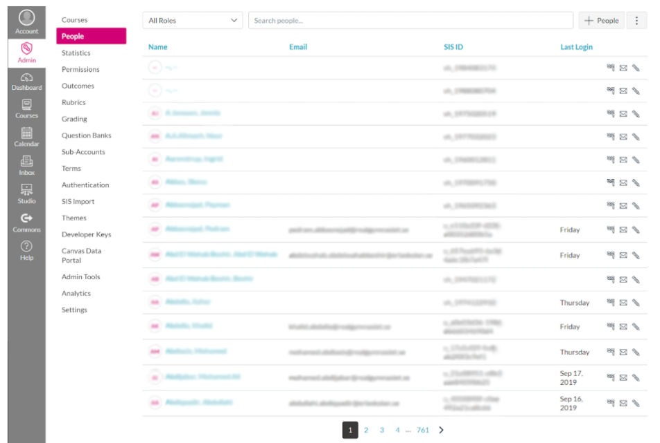
A GET call to the Canvas LMS REST API endpoint at /api/v1/accounts/:account_id/users is required to retrieve user data for the user administration page. Administrators with the necessary rights can access this endpoint to get a list of every user connected to a certain account. Any legitimate account ID within the Canvas instance is represented by the :account_id option in the endpoint.
A paginated list of users connected to the given account is what the API response looks like. Four parameters can be included to the GET request in order to improve the query: the kind of enrollment, the search phrase, the column for sorting results, and the desired order (descending or ascending). These characteristics help to enhance and personalize the information that is obtained. Table 3.1 provides a detailed explanation of each option, allowing administrators to customize their calls to the Canvas LMS REST API in order to retrieve certain user data.

Slide 5
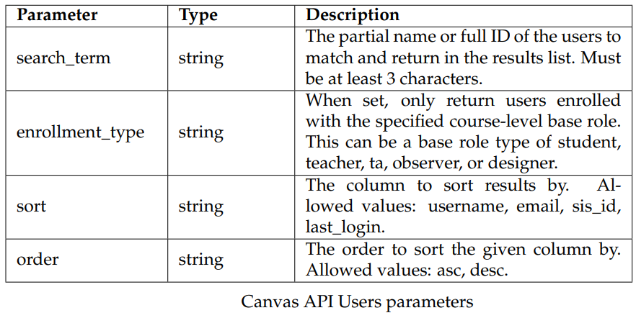

Slide 6
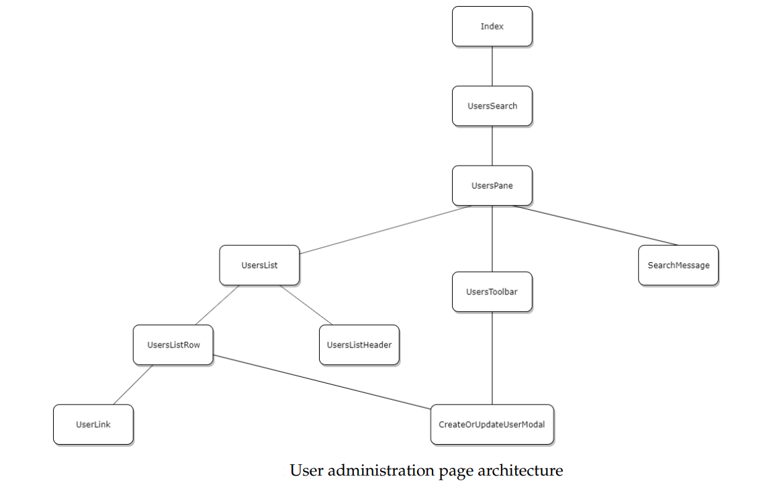
Architecture of users' administration pages
Figure depicts the architecture of the user administration page.

Slide 7
The index component serves as the application's entry point and is in charge of rendering material to the DOM using the react-dom library's ReactDOM.render function. This part of the Canvas LMS platform was first used to manage accounts and courses. But in this particular application, the emphasis is only on the User Administration page, hence the capability for displaying the account and course pages has been removed. Originally called AccountCourseUserSearch and intended for the account and course pages, the second component in the tree is now called UsersSearch. Features supporting the account and course pages were also removed in order to simplify the program and focus on the User Administration page.
Since they have no effect on the data flow inside the program, several leaf nodes in the component tree have been left out of Figure for clarity. Input fields, buttons, links, loading indications, and icons are examples of leaf node components. These components are from Instructure's open-source React component library, instructure-ui, a third-party library.

Slide 8
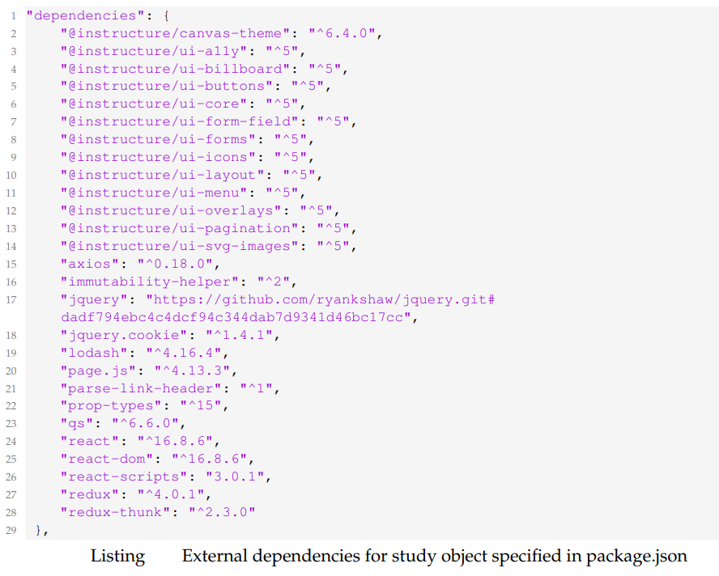
It was important to separate the user administration page from the rest of the platform by developing a standalone application in a local development environment before performing the Design Science Research on it. This required taking the source code and all of its dependencies out of the GitHub Canvas LMS project.
There were dependencies on external libraries and internal modules in the repository for the user management page. NPM was used to handle the external dependencies, which are listed clearly in the package.json file, as seen in Listing.

Slide 9
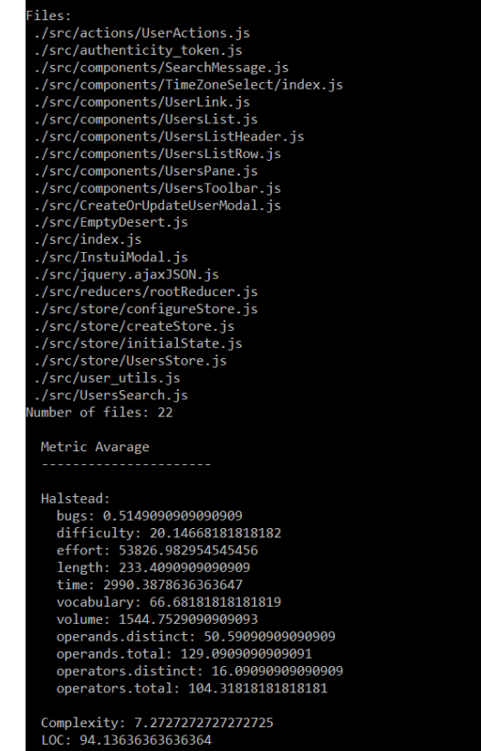
To calculate some metrics, Plato, the static code analysis tool covered in Section 2.2, was used. The Node Package Manager (NPM) was utilized to complete the Plato installation. With the use of this tool's numerous customization options, users may exclude particular files, change other parameters, and add a title and date to the report. A script may be used to execute Plato for a more customized analysis.
Metrics like cyclomatic complexity and Halstead metrics do not by default have average values included in the reports that Plato generates.
This was addressed with the development of a bespoke Node.js program, analyze.js, which can be found in the application's root folder. By calculating average values across the board, this tool provides a thorough analysis for various implementations. Figure 3.3 shows an exemplary output of this program.

Slide 10
Eliminating empty source code files from a system's average values calculation might result in an incorrect maintainability estimate. The number of files need to stay constant in order to provide an accurate comparison between various implementations in every iteration. As a result, whenever necessary, empty JavaScript files with zero complexity were inserted.
The create-react-app tool, described in Section 2.6, was used to build up the development environment for the study object in the initial implementation. All automatically created source files were eliminated, with the exception of index.html and index.js, which serve as the application's entry point. The created src folder of the program was then updated with the source code unique to the users' administrative page.
Using the createStore function from the Redux library, the application adheres to the Redux architectural pattern. The redux-thunk middleware is added to this function to manage asynchronous operations. Two input arguments are needed for the createStore function: a reducer and the store's starting state. Listing 3.2 shows the starting state, which consists of an object named userList with five fields: users, isLoading, errors, links, and searchFilter.

Slide 11
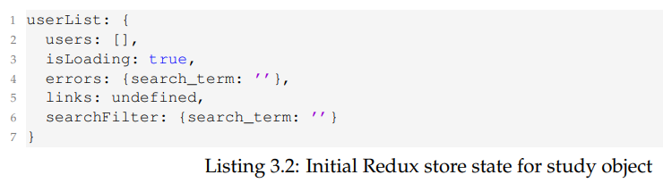
Some fields in the application are considered local data, whereas user data is retrieved remotely from the Canvas LMS API. A few fields that were associated with flipping between the account, course, and user pages were eliminated from the original version as they were not crucial to the running of the program.
The store is updated by a single reducer called rootReducer in response to dispatched actions. Every action object follows the Flux pattern, with a type and a payload. The payload has the data that needs to be modified, and the type decides the action to do. Five different actions are handled by the rootReducer:
GOT_USERS: Modifies the pagination links for users, sets the loading status to false, and updates the state with new user data.
GOT_USER_UPDATE: Modifies a single user within the array called users.
Updates the search filter, taking into account the search phrase, role, page, and order (UPDATE_SEARCH_FILTER). Additionally, it resets the too-short search term's error status.
SEARCH_TERM_TOO_SHORT: Inserts a message indicating a "term too short" into the errors state.
The isLoading state is updated to true by LOADING_USERS.

Slide 12
Upon startup, the UsersSearch component receives the Redux store as a property, enabling the user interface to access it. The Redux store is then handed to the UsersPane component further down the component tree.
As the only component linked to the Redux store, the UsersPane component is essential to the application. It is in charge of sending actions to update the store, propagating store data throughout the component tree, and subscribing to changes in the Redux store. The getState() function in the class-based UsersPane component's constructor retrieves the current Redux store state, and the setState() method inherited from React.Component stores this data in the UsersPane component's local state.
The UsersPane component defines two lifecycle methods: componentDidMount and componentWillUnmount. The handleStateChange class function, which is a change listener that updates the local state of the component if the store state changes, is set up by the component when it subscribes to the Redux store using the componentDidMount method. The component unsubscribes from store changes using the componentWillUnmount function.
Two actions are delivered using the dispatch method after component mounting and Redux store subscription. The updateSearchFilter action generator generates the first action, which modifies the store's searchFilter state using URL query parameters that are provided down as properties from the UsersSearch component. The first user fetch is triggered by the second action, which is started by the originator of the applySearchFilter action.

Slide 13
The application's applySearchFilter action maker carries out the following series of actions:
obtains the search filter's current condition.
determines if the search phrase is at least the required minimum length or is empty.
An action named displaySearchTermTooShortError of type SEARCH_TERM_TOO_SHORT with a payload containing an error message is triggered if the search term is too short. The UsersToolbar component uses this error message.
The action loadingUsers with type LOADING_USERS and empty payload is initially sent if the search term is valid. It then starts the asynchronous user fetching process.
Once the fetching process is finished, the users are returned in a response and sent in a new action called gotUserList. The users and the XMLHttpRequest object containing the pagination links are included in the payload of the gotUserList action, which is of type GOT_USERS.
Notes:
The UsersStore object provides methods for running asynchronous network queries with the help of the jQuery framework, making it easier to get users from the Canvas LMS API. Using the createStore function, which offers the essential functionality and may be enhanced with specific attributes, is how the UsersStore is created. The createStore method is used for different reasons in different areas of the Canvas platform. In order to optimize the study object and enable more accurate comparisons with other implementations, functionality that was not needed was eliminated from the User administration page.

Slide 14
Two methods are supplied to control the behavior of collecting users when the UsersStore is initialized using the createStore constructor. These functions are getUrl and normalizeParams.
The getUrl method ascertains the URL from which users are to be retrieved. It is essential to establish the endpoint that user data is retrieved from.
The normalizeParams method is set up to include default parameters in the fetching URL while removing erroneous values from the search filter URL. There are now two default parameters available:
The first default option makes sure that each user row that is provided has information about the user's timezone, email address, avatar URL, and last login date in addition to other necessary parameters.
The number of users to be returned is determined by the second default option, which is set to fifteen.
Notes:
In turn, the createStore function uses the given getUrl and normalizeParams to build an object with a load method. The load function is in charge of retrieving users via the jQuery library's Ajax technique. To provide a reliable user-fetching method, it is expanded to include features like error handling, authentication, and JSON response processing.

Slide 15
The essential metrics listed in Section 2.3 were measured in order to assess the maintainability of the application. These metrics were chosen based on their applicability in evaluating the design of the application as well as their compatibility with the Plato tool.
Design Complexity of Card and Agresti: This metric, used in the assessment, measures the application's local complexity (cohesion) as well as its structural complexity (coupling). It sheds light on how interdependent parts are and how cohesive the codebase is overall.
Software Science Effort: This additional metric is taken into account and provides a measurement of the total complexity and, hence, the application's maintainability. This measure, assessed by Plato, helps anticipate possible difficulties and comprehend the amount of work needed to execute a program.

Slide 16
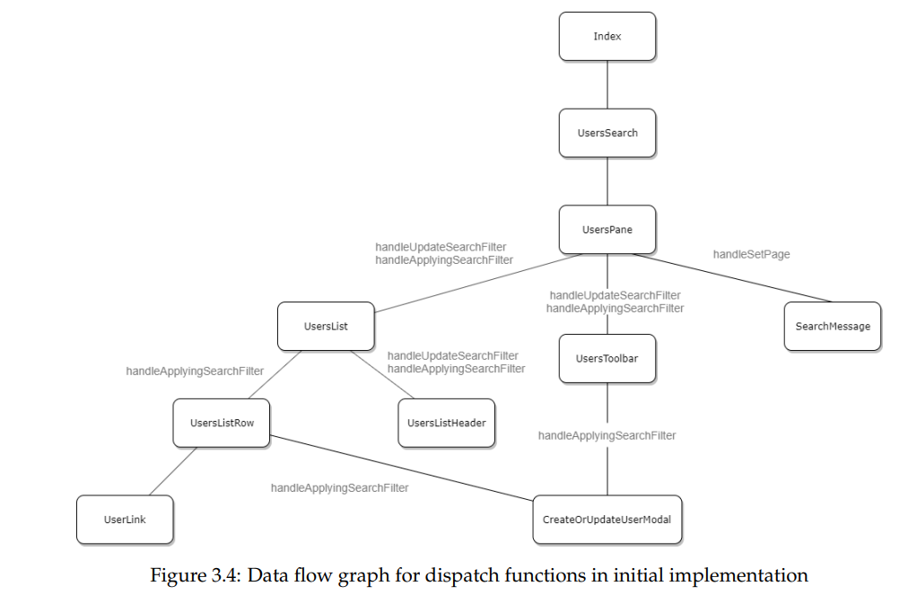
Cyclomatic Complexity: This measure evaluates the source code complexity and is the third one used. It contributes to a thorough grasp of the overall complexity by making complicated portions within the codebase easier to recognize.
Lines of Code (LOC): This last statistic, which gives an indication of the size of the source code, is used in the assessment. This measure helps to assess the application's complexity by taking into account the amount of code and possible maintenance issues that come with its size.
Together, these metrics provide a comprehensive assessment of the application's maintainability, illuminating its intricate structural, functional, and size-related details. The selection of these metrics corresponds with their importance in measuring various aspects of maintainability, enabling a thorough evaluation of the application's architecture.

Slide 17
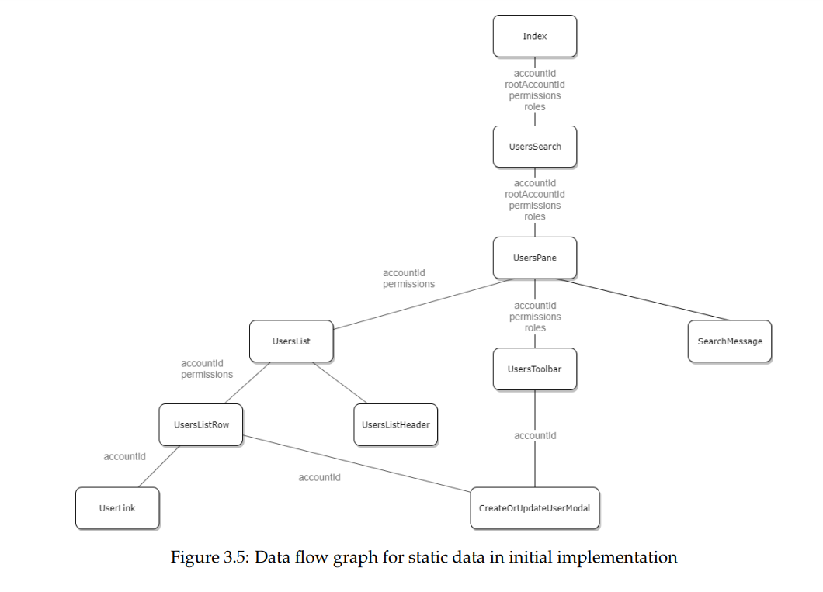
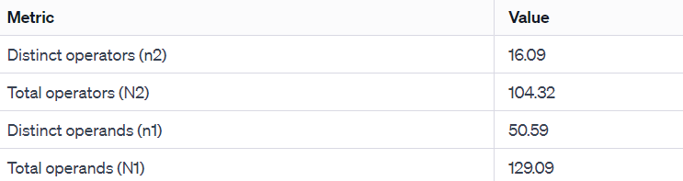
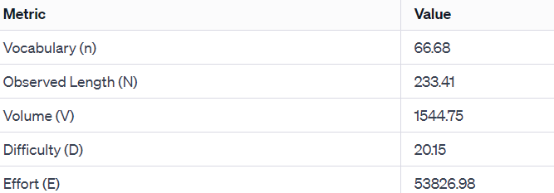
Plato was used to assess the Software Science Effort for the first implementation, in addition to a bespoke script designed to determine average values per file. As shown in Table 3.3, the measurement produced the following outcomes for the number of operands and operators:
The average Software Science Effort metrics were then calculated using these values, as shown in Table 3.4:

Slide 18
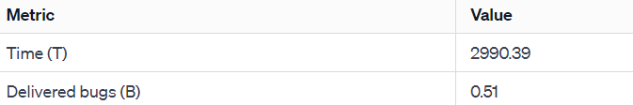
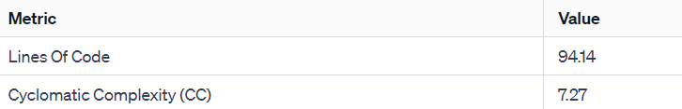
Estimates for implementation time and the quantity of supplied defects were computed using the Software Science Effort value; the results obtained are shown in Table 3.5:
Moreover, Table 3.6 provides specifics on extra measures for average Lines of Code (LOC) and Cyclomatic Complexity (CC), which were determined using Plato:
These comprehensive metrics provide a quantitative insight into various aspects of the initial implementation's complexity and potential challenges in terms of Software Science Effort, development time, and bug estimation.

Slide 19
References:
Instructure.com, 2019. About Canvas | Edtech Learning Platform | Instructure. [Online] Available at: https://www.instructure.com/canvas/about [Accessed 20 Nov. 2019].
Iso.org, 2019. ISO/IEC 25010:2011. [Online] Available at: https://www.iso.org/obp/ui/#iso:std:isoiec:25010:ed-1:v1:en [Accessed 20 Nov. 2019].
Iso.org, 2019. ISO/IEC 9126:1991. [Online] Available at: https://www.iso.org/standard/16722.html [Accessed 20 Nov. 2019].
Krasner, G. and Pope, S., 1998. A cookbook for using the model-view-controller user interface paradigm in Smalltalk-80. Journal of Object-oriented Programming - JOOP, 1.
Leff, A. and Rayfield, J.T., 2001. Web-application development using the Model/View/Controller design pattern. In: Proceedings Fifth IEEE International Enterprise Distributed Object Computing Conference, pp.118–127.
McCabe, T.J., 1976. A Complexity Measure. IEEE Trans. Softw. Eng., 2(4), pp.308–320.
McCabe, T.J. and Watson, A.H., 1994. Software Complexity. CrossTalk, 7(12), pp.5–9.
McConnell, S., 2004. Code Complete, Second Edition. Microsoft Press.
MDN Web Docs, 2019. About JavaScript. [Online] Available at: https://developer.mozilla.org/en-US/docs/Web/JavaScript/About_JavaScript [Accessed 20 Nov. 2019].
MDN Web Docs, 2019. Same-origin policy. [Online] Available at: https://developer.mozilla.org/en-US/docs/Web/Security/Same-origin_policy [Accessed 20 Nov. 2019].

